Slide 1
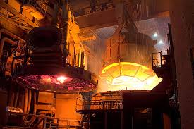
Alloy Steel Industry in India
Alloy Steel Producers Association of India
March 20, 2018

Slide 2
Alloy Steel Business
Steel Industry
Flat Products
Long Products
Mild Steel, High Carbon, & Construction
Alloy Steel
& Stainless Steel
Alloy Steel Constitutes around 8.4% of Indian Steel Demand

Slide 3
Steel containing alloying
elements like Chromium, Nickel, Molybdenum, Vanadium used in highly specialized applications in Automotive, Engineering, Railways & Defence sectors
Alloy Steel

Slide 4
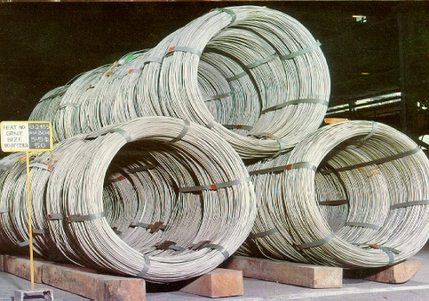
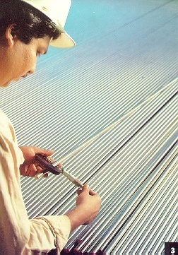
Alloy Steel - Product Profile
Grades:
More than 400 varieties
Products:
Bars
Wire rods
Wires
Bright bars
Sizes: Wide range varying from 3 mm to 250 mm
Shapes:
Rounds, Squares, Flats, Hexagons, Rectangles and Customized shapes

Slide 5
Alloy Steel
Requirements of alloy steels are in small batches ranging from 500 Kgs to 60 MT per grade.
Each Alloy steel grade is tailor-made as per customer specification, quantity requirements and end application
It is not a commodity product

Slide 6
Leading Alloy Steel Producers
KALYANI

Slide 7
Alloy Steel : Customer Profile

Slide 8
Alloy Steel : Customer Profile

Slide 9
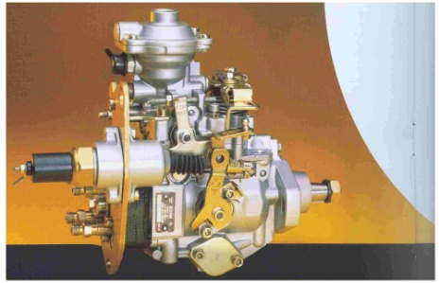
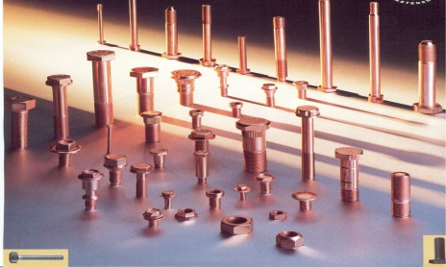
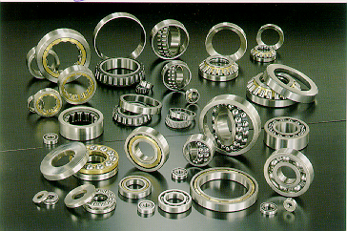
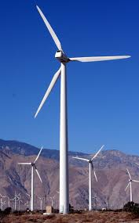
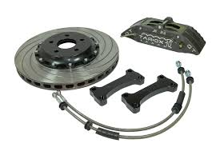
Alloy Steel - End Applications
Transmission parts
Engine components
Steering components
High tensile fasteners
Fuel injection pumps
Bearings
Braking system
Suspension parts
Wind Mill

Slide 10
Alloy Steel – Current Status
Indian Alloy Steel production accounts for 5% share in global alloy steel production
Alloy Steel making capacity in India at present is approximate 10 million tonnes
Alloy steel demand in India is pegged at 7-8 million tonnes per annum
Encouraging per capita consumption of alloy steel is a challenge
Note: * Industry Estimates
Excludes Stainless Steel Production

Slide 11
Alloy Steel Industry– Growth Potential
Forecast of Alloy Steel* Demand
 | 2025-26 | 2032-33
Alloy Steel Demand at….
If, 6.5% GDP Growth Rate | 11.2 | 19.2
If, 7% GDP Growth Rate | 13.0 | 20.9
If, 8% GDP Growth Rate | 14.6 | 24.0
in million tonnes * Excludes stainless steel Source: Long Term Perspective Report by MoS, May 2014
The alloy steel demand, which is at 7-8 MT, is likely to double by 2025-26
The production, which is at 6 MT will also double to 12 MT by 2025-26
The capacities are expected to increase from 10 MT to 20 MT by 2025-26

Slide 12
Alloy Steel Producers Association of India
About Us:
Established in 1968, the Association represents producers of Alloy & Special Steels, including stainless steel, in the country. The Association widely represents the domestic Alloy Steel Industry
ASPA seeks to promote common interests of alloy and special steel manufacturers in India.
* ASPA continuously interacts with Government of India’s relevant ministries, mainly Steel, Commerce and Finance on policies and procedures that affect alloy steel industry.
* ASPA interacts periodically with its principal customers organisation such ACMA (Automotive Components Manufacturers of India) and SIAM (Society of Indian Automobile Manufacturers).

Slide 13
Alloy Steel Producers Association of India
Contact Us:
Suketu V Shah
Chairman
ASPA Registered Office
Alloy Steel Producers Association of India
Bajaj Bhavan, 3rd Floor, Nariman Point,
Mumbai 400021 – Maharashtra – India
Tel: 022-61216666
www.aspaofindia.weebly.com
ASPA Secretariat Office
Admin Bldg 1, c/o Mukand Ltd
Thane Belapur Road,
PO Kalwe,
Dist. Thane 400605
Maharashtra – India
Tel: 91-22-21727359
Fax: 022-25348179
Email: aspaindia1@gmail.com
ASPA Delhi Office
D-307 Defense Colony,
New Delhi-24
Tel: 011-49070548 Ext 511

